Slide 1
PLATFORM FUNCTIONALITIES AND VISUALIZATION
IoT PLATFORM ADVANTAJES
The IoT platform developed by everis with Niagara as a middleware has several advantages, from analytics and visualization to hardware and connectivity
Ability to model and transform useful information, graphs and tables, for conclusions, decision making and suggestions for optimization
Predictive Analytics
& ML
Capacity of analyze historic data with data mining, predictive modelling, and machine learning, to make predictions
Dashboards & Visualization
Connectivity
Friendly visualization, with dashboards and modules to monitor and control the different sensors, alarms, update parameters, etc
Mobile, WiFi, Zigbee and other communication technology capability. Ports for cable connection, industrial devices and signals
IoT Platform
Small size, good computing power, robust encapsulation for industrial environments with high capacity of heat dissipation
Hardware
Centralization
Ability to control multiple gateways from a central station, mass upgrades of remote stations and centralization of information
Controls
Capacity of remote and/or automatic control of elements such as air conditioning, ventilation, accesses, switches, etc.
Multiple industrial connectors developed and easy integration of new installation elements

Slide 2
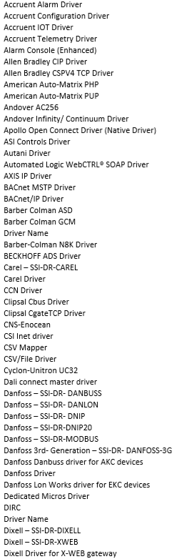
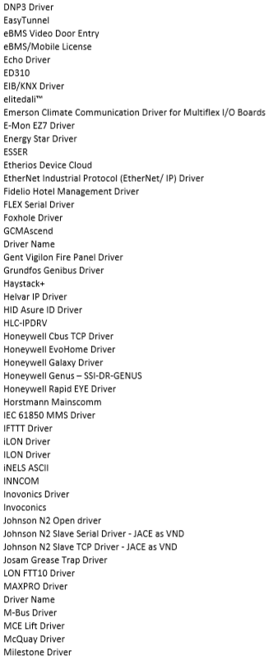
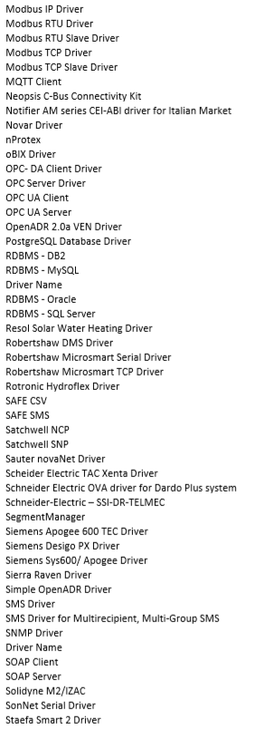
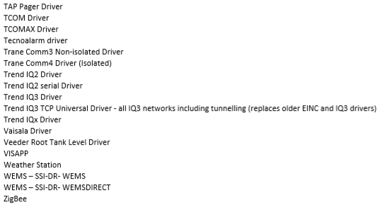
TECHNICAL ARCHITECTURE
CONNECTIVITY - COMMUNICATION PROTOCOLS
Niagara has different communication protocols to integrate with the different equipment and sensors, and obtain the necessary information for control and monitoring
Niagara compatibility protocols:

Slide 3




TECHNICAL ARCHITECTURE
CENTRALIZATION -
xx

Slide 4
TECHNICAL ARCHITECTURE
CONTROLS - COMMUNICATION PROTOCOLS
xx
xx

Slide 5

TECHNICAL ARCHITECTURE
CONTROLS & MAINTENANCE – SOFTWARE MAINTENANCE
Niagara 4 offers maintenance support for its software that includes the following features:
Program summary
18 months included with every license (additional years can also be purchased up front)
Gap charges apply if SMA purchases after expiration (5-year max)
All update builds, patches and upgrades are provided as part of SMA
Value propositions
Many end users explicitly ask for a maintenance program to reduce risk
Distributors no longer worry about out-of-date versions sitting in stock
System integrators can add SMA to service programs – additional value
Support period for Niagara 4
Standard release: 4 years from release
Long-term release: 7 years from release
Niagara AX v3.8 is designated a long-term release
Tech support available until product EOL

Slide 6
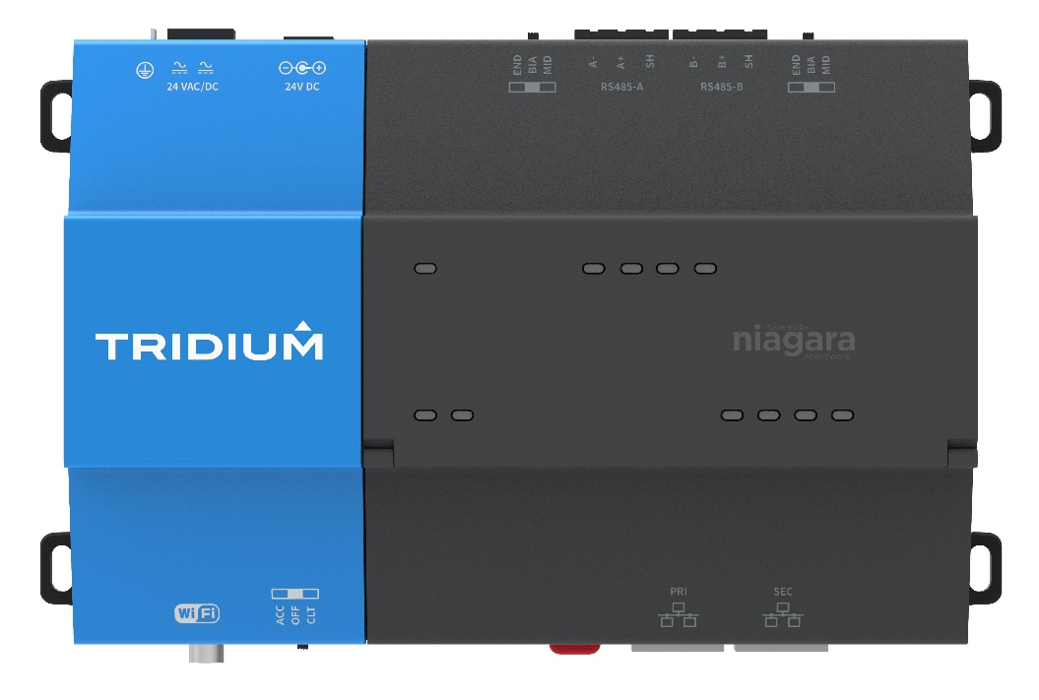
TECHNICAL ARCHITECTURE
HARDWARE – ABOUT TRIDIUM NIAGARA PLATFORM
Tridium has created an all-new hardware platform optimized for Niagara 4: the JACE 8000 controller. This next-generation controller features a global design that functions with legacy systems and has the ability to scale for future needs. The JACE 8000 controller offers significant improvements over previous generations.
Main benefits
Efficient Global Design
Wireless Capability
Optimized for Niagara 4
Tridium platform key features
Designed for the control of intelligent building elements, such as air conditioning, ventilation, accesses, etc.
Global capacity licensing and upgrade capability
Modular hardware design for fast and easy installation
Expandable with up to four option modules
24VAC/DC – Standard global power supply
Intuitive user interface
Rich choice of different colors, materials and finishes for differentiated OEM Brand identification
Connectivity profiles

Slide 7
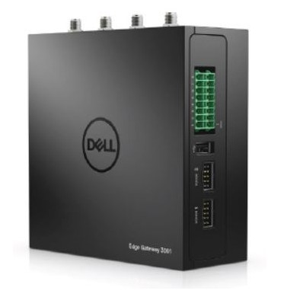
TECHNICAL ARCHITECTURE
HARDWARE – ENVIRONMENT SENSOR
Dell Edge Gateways are intelligent devices designed to aggregate, secure, analyze and relay data from diverse sensors and equipment at the edge of the network. These gateways bridge both legacy systems and modern sensors to the internet, helping you to get business insights from the real-time, pervasive data in your machines and equipment.
Main benefits
Small, mighty and tailored for your work
High connectivity capacity
(Mobile, WiFi, Zigbee, etc..)
High mobility and adaptability
DELL Edge 3000 series key features
Robust encapsulation for industrial environments with high heat dissipation
Multifunction GPIO port (8-channel) for expansion and programmable Serial (2 x RS232 or 422 or 485)
Connect via Ethernet (10/100), WWAN/Cellular, WLAN/Bluetooth LE/Wi-Fi
Intel® Atom™ E3805, 2GB RAM, and 8GB eMMC (32GB w/WWAN)
Operating range of -30°C to 70°C, flexible mounting options, and the ability to withstand high/low temperatures and high shock and vibration
Integrated GPS, accelerometer and atmospheric pressure sensors

Slide 8
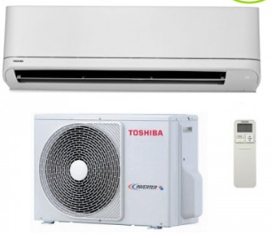
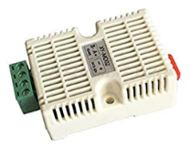
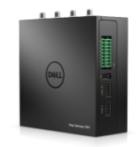
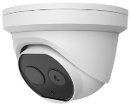
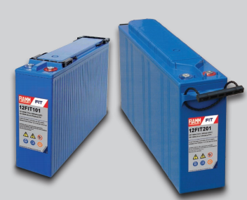
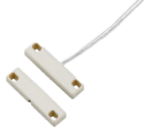
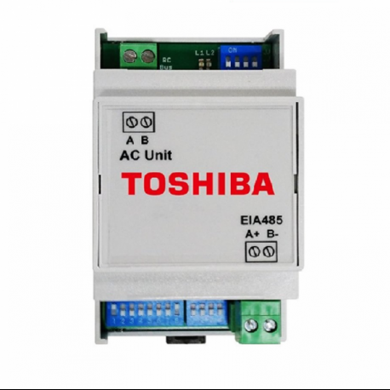
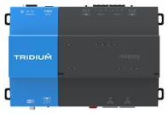
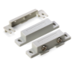
TECHNICAL ARCHITECTURE
HARDWARE – EQUIPMENT LAYOUT
The first step is to make sure to have everything we need for the development of the IoT platform and be able to connect with the equipment needed to control and to be able to gather information from the sensors
Equipment to Control and motorize:
Sensors and Gateways for Control the Site Environment and Security:
Hardware to Gather, Control and Analyse the Information:
Air Conditioning
TOSHIBA Manoza RAV-RM**1KRTP-E 3000 frgs
Environment Sensor
Modbus RS485
For temperature and humidity control
Thermal Camera
Dual IP Camera To monitor the temperature in different points
Environment Sensor
3001 DELL series To aggregate, secure, analyze and relay data
Batteries
FIAMM 12 FIT 101
Magnetic Switch
Switch MS-1 model
Protocol Comm. Gateway
MODBUS BMS-IFMB0TLR-E
Tridium Niagara
Platform to build internet‐enabled products
*For the Air Conditioning we made sure it was the same model (at least in the majority) as the Air Conditioning in potential clients Sites

Slide 9

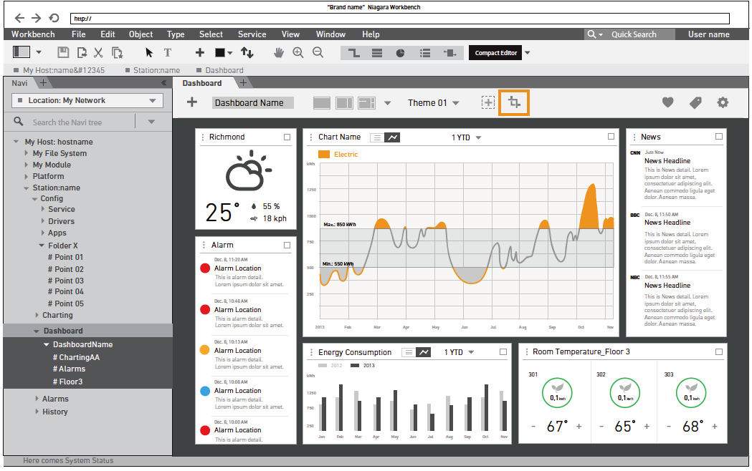
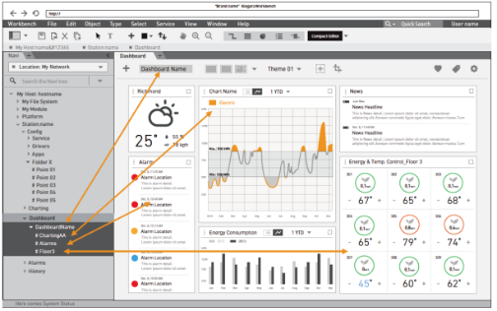
TECHNICAL ARCHITECTURE
DASHBOARDS & VISUALIZATION
Integrators can provide an interface that empowers users to do more on their own. Because devices, systems and data points can be tagged in Niagara 4. This one-tool utilized tag hierarchies to automatically integrate all data in a navigation tree.
Niagara 4 – Navigation and Dashboards
Preparation and configuration of real-time dashboards
Element navigation system based on hierarchies and labels
Automatic integration of elements in the database via labels
Allows the final user to modify elements without access to the system's engineering

Slide 10
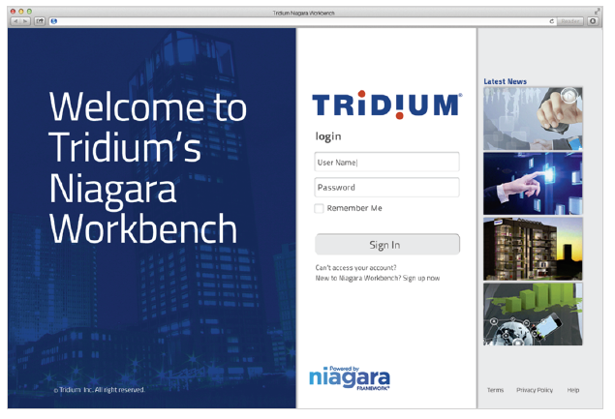
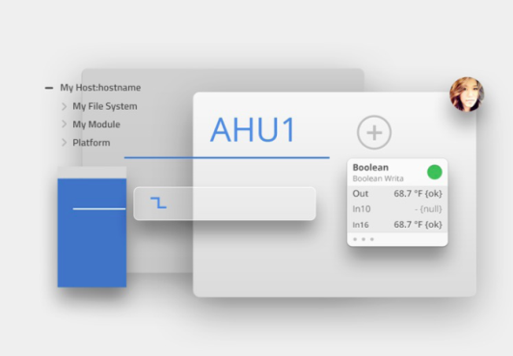
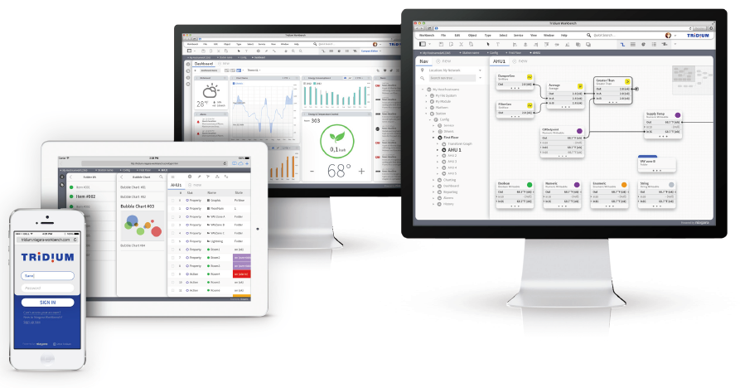
TECHNICAL ARCHITECTURE
DASHBOARDS & VISUALIZATION: USER INTERFACE
Niagara 4 features a bold, intuitive and easy to use interface. The platform utilized HTML 5 to provide an array of rich features and its powerful new UI framework makes the user experience simpler and more robust, giving users maximum control of their data and decisions.
Niagara 4 – User Interface main features & image examples
Homogeneity in design and language between platforms (desktop, tablet and phone)
HTML5 provides more functionality and stability

Slide 11

TECHNICAL ARCHITECTURE
DASHBOARDS & VISUALIZATION: CYBERSECURITY
Niagara has developed a strong cybersecurity system to ensure that all information for control and monitoring is protected at all times. Niagara 4 takes a “defense-in-depth” approach to IoT security. Building on the security of previous Niagara versions.
Niagara Cybersecurity features:
Extremely robust model, developed directly on the Niagara Framework
Fully adjustable authentication strategies
Authentication of users using secure credentials by default
Authentication requires users to choose strong credentials, and both data in motion and sensitive data at rest are encrypted.
Role-Based Access Control (RBAC) for configuring access permission and avois error-prone.
Managing user roles and associated permissions using tags
Authentication can be configured according to connection type
Integration with enterprise identity managers and access systems (LDAP, Kerberos)
Digital signatures to ensure application integrity
NIST-validated FIPS 140-2 Level 1 optional
Dedicated cybersecurity team for the development of constant improvements
Logging of all user security actions and events for audit purposes

Slide 12

TECHNICAL ARCHITECTURE
PREDICTIVE ANALYTICS & MACHINE LEARNING
Niagara4 Support for the generation of analytics on the large amount of data generated for direct action as a result of the analysis.
Application of the required logic on the data coming from the automation systems through the simultaneous application of rules and statistics for the discovery of knowledge that allows Niagara to take certain actions on those systems
Analytics Vs Alarms
Alarms
Thresholds and alarms need to be defined in advance
No intelligence; requires operator interpretation
Analytics
It allows the search for patterns and exceptions
It is possible to configure rules that generate "intelligent alarms"
Provides results that show how systems are actually operating

Slide 13
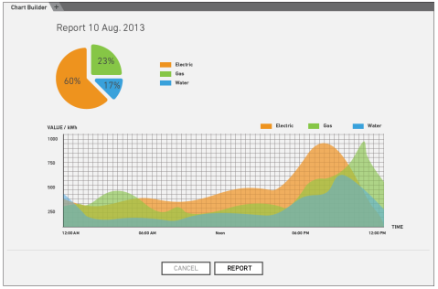
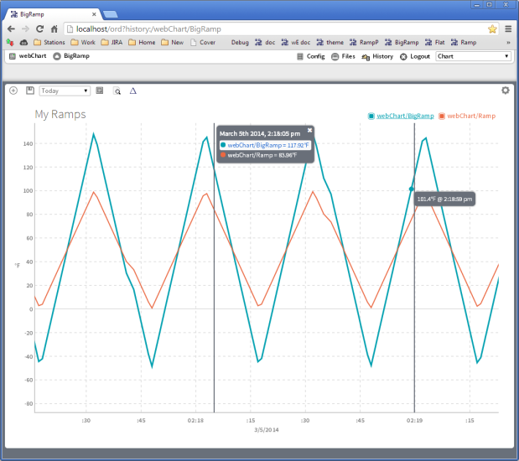
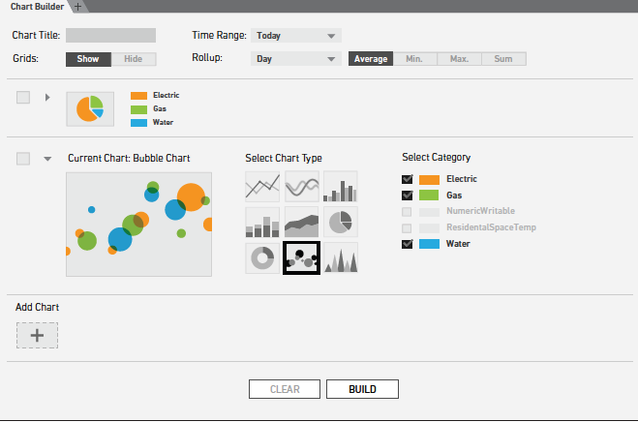
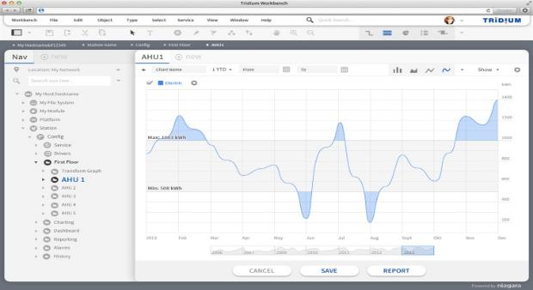
TECHNICAL ARCHITECTURE
PREDICTIVE ANALYTICS & MACHINE LEARNING: ADVANCED GRAPHS AND REPORT
Niagara4 offers the possibility to create graphs with different parameters and characteristics, allowing easy comparisons of points and ranges. The following are some key features:
Easy and quick search and access to information through the use of labels
"Drag 'n' Drop" parameterizable for end users

Slide 14
TECHNICAL ARCHITECTURE
PREDICTIVE ANALYTICS & MACHINE LEARNING: ADVANCED GRAPHS AND REPORT
Niagara4 offers the possibility to create graphs with different parameters and characteristics, allowing easy comparisons of points and ranges. The following are some key features:
Easy and quick search and access to information through the use of labels
"Drag 'n' Drop" parameterizable for end users

Slide 15

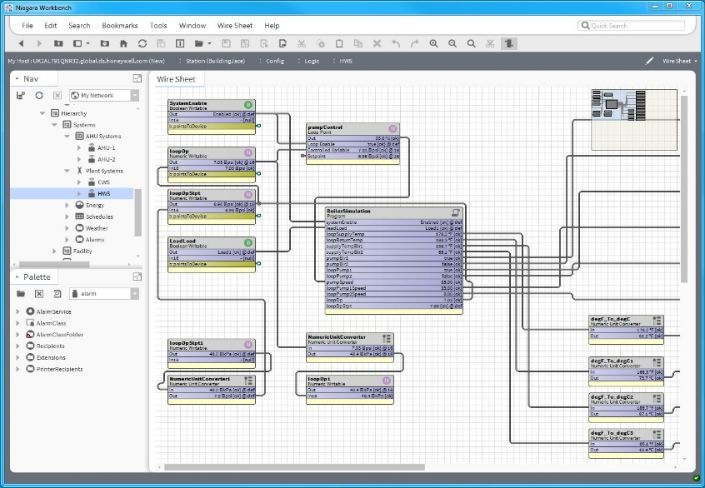
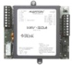
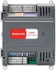
TECHNICAL ARCHITECTURE
PREDICTIVE ANALYTICS & MACHINE LEARNING: INFORMATION FLOWS
The Niagara Framework helps users connect and control disparate devices and systems, and harness the power of the IoT. The following are the key advantages:
All the information in real time is standardized in any component so that it can be treated in a homogeneous way
Each point is represented as data in the system
Otros
BACnet
Niagara

Slide 16
TECHNICAL ARCHITECTURE
Niagara 4 – Data Modeling
Niagara4
All the information in real time is standardized in any component so that it can be treated in a homogeneous way
Each point is represented as data in the system
Otros
BACnet
Niagara

